Slide 1
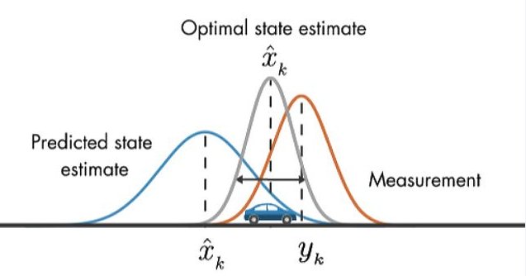
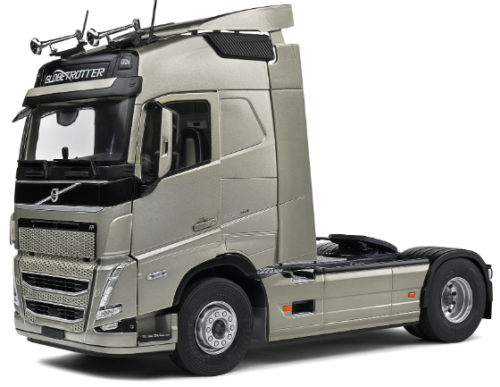
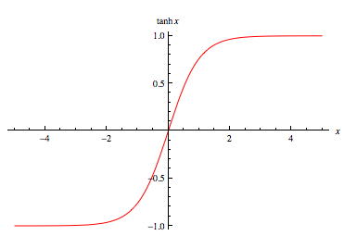
Architecture
Extended Kalman Filter
Uplevel controller (MPC)
States
Lidar
Steering
Process Propagation
Position
Constraints
IMU
Velocity
Measurement Update
Heading Angle
MPC Controller
GPS
Target State
Throttle/Brake
Longitudinal Control
Measurement
Lateral Control
Steering
Local controller (PID)
Scaled by tanh(x)

Slide 2
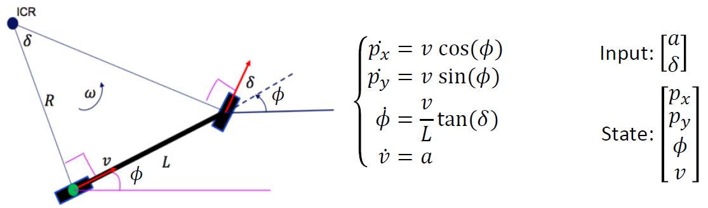
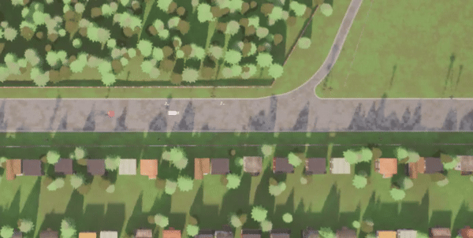
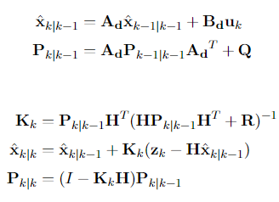
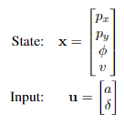
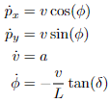
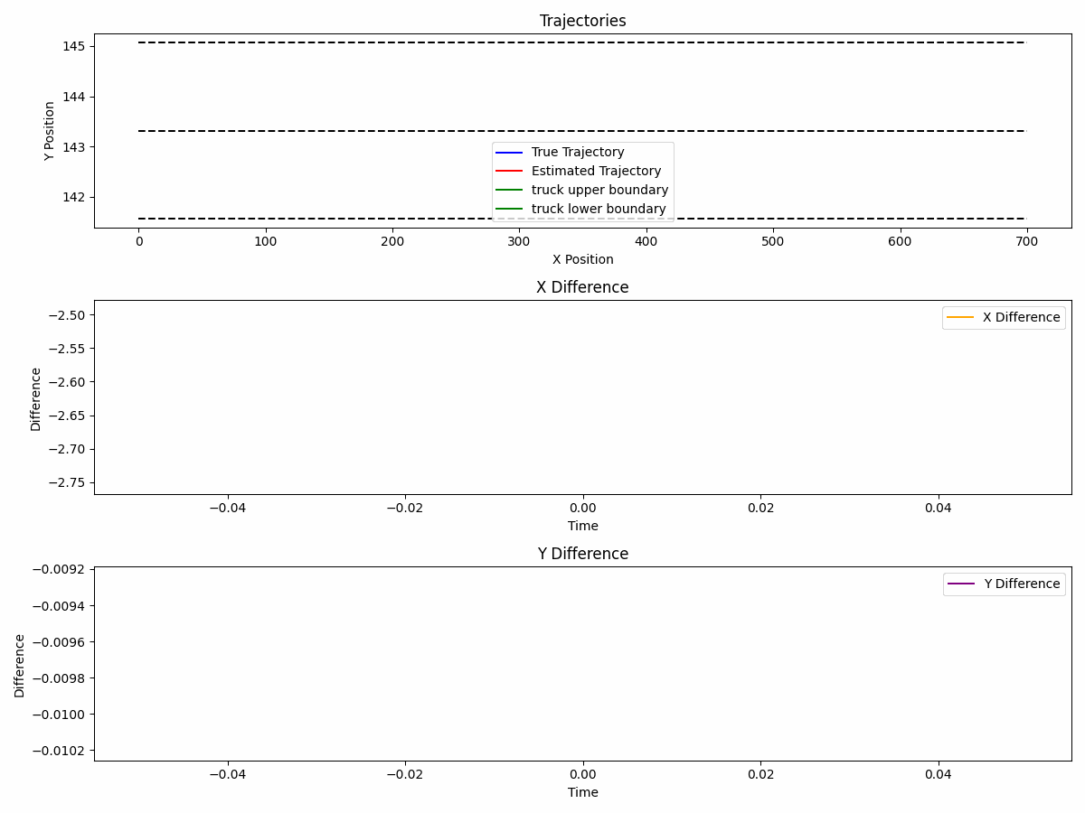
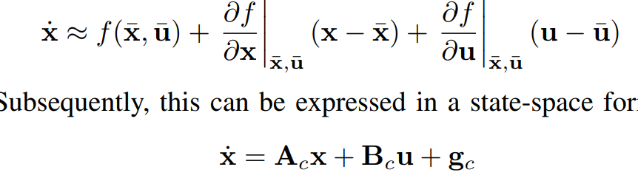
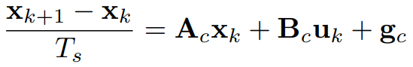
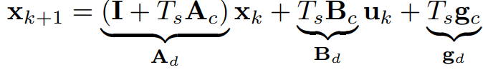
Process Model(Using LTV Model)
Extended Kalman filter
Process Predict(Kalman filter)
Measurement Update(Kalman filter)
H is Identity matrix
Stationary P is used to calculate tighten bound

Slide 3
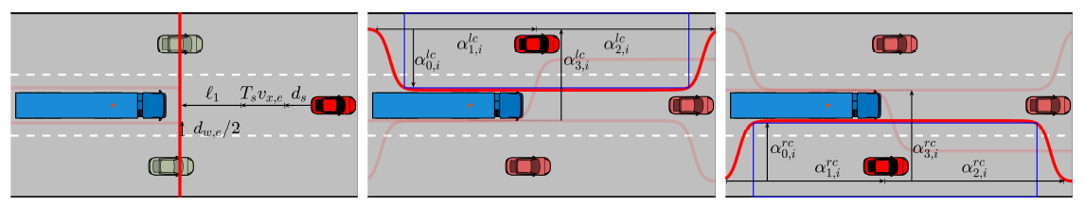
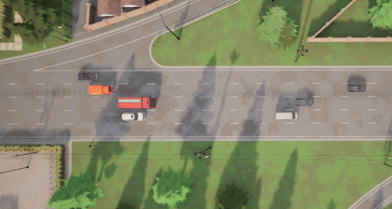
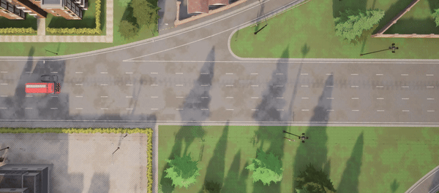
MPC Controller
Trailing Controller
Left Lane Change Controller
Right Lane Change Controller
The highway autopilot uses a trajectory planner and three predictive controllers for trailing and lane changes, employing vehicle prediction to optimize trajectories via a Decision Master. Each cost function aims to track trajectory while minimizing the control input and the change of the input.

Slide 4
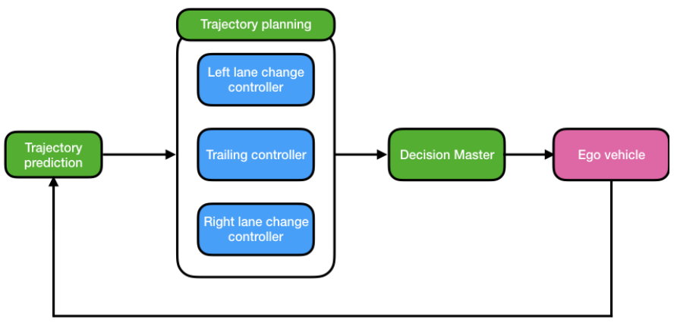
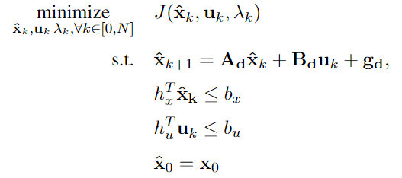
MPC Controller
Trailing controller
Left lane change controller
Decision Master
Right lane change controller

Slide 5
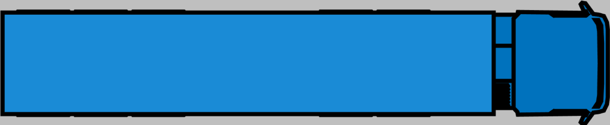
Trailing controller
Left lane change controller
Right lane change controller

Slide 6
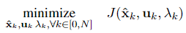
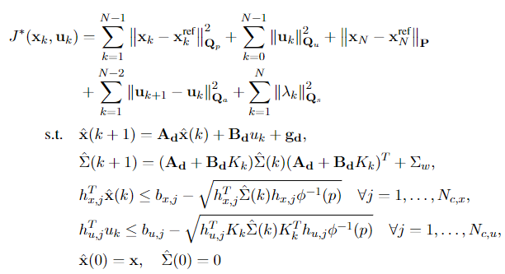
RMPC Controller Architecture
Trailing controller
Left lane change controller
The highway autopilot uses a trajectory planner and three predictive controllers for trailing and lane changes, employing vehicle prediction to optimize trajectories via a Decision Master. Each cost function aims to track trajectory while minimizing the control input and the change of the input.
Right lane change controller

Slide 7
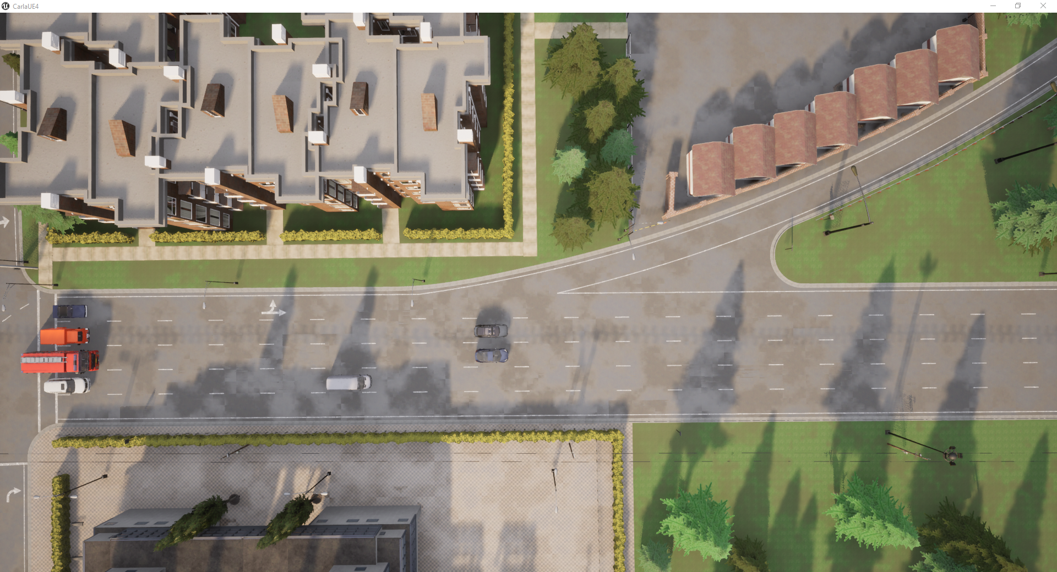
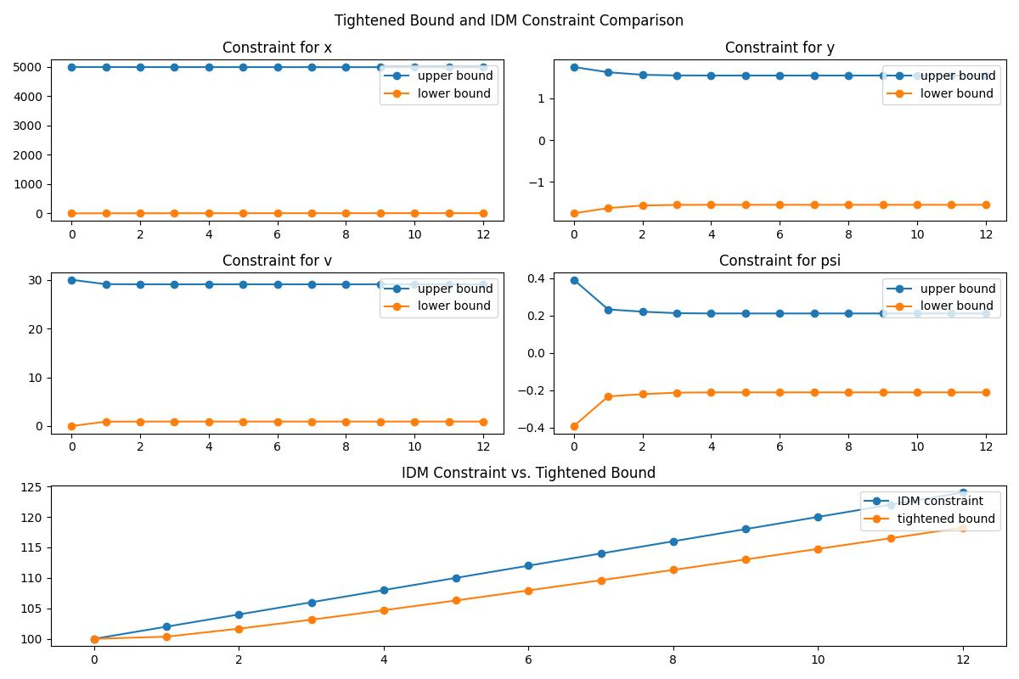
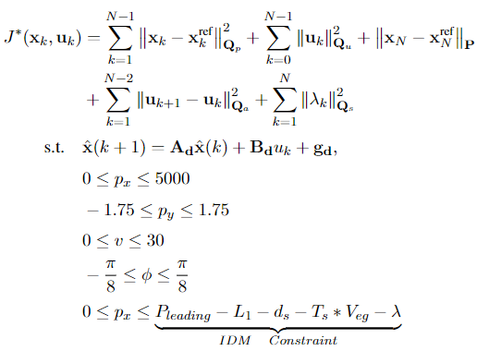
Adaptive Cruise Control
For Adaptive Cruise Control (ACC), an Intelligent Drive Model (IDM) constraint is applied along the x-axis. Due to difference between the nominal model and actual vehicle, this uncertainty is modeled as Gaussian noise. To compensate, constraints are tightened using Stochastic Model Predictive Control (SMPC).
Trailing controller
Tightened Bound with time (example)
Initial Constraints
SMPC Constraints
As time progresses, the constraints are increasingly tightened to approach noise effects.

Slide 8
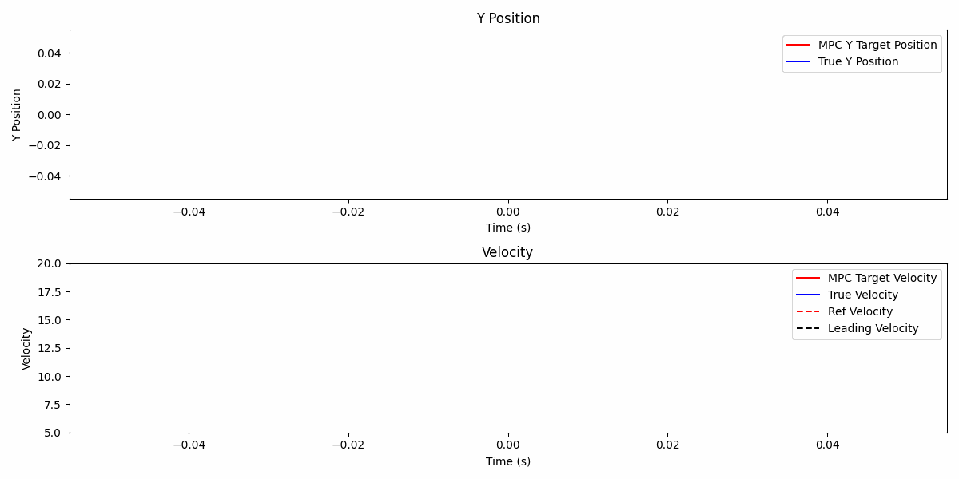
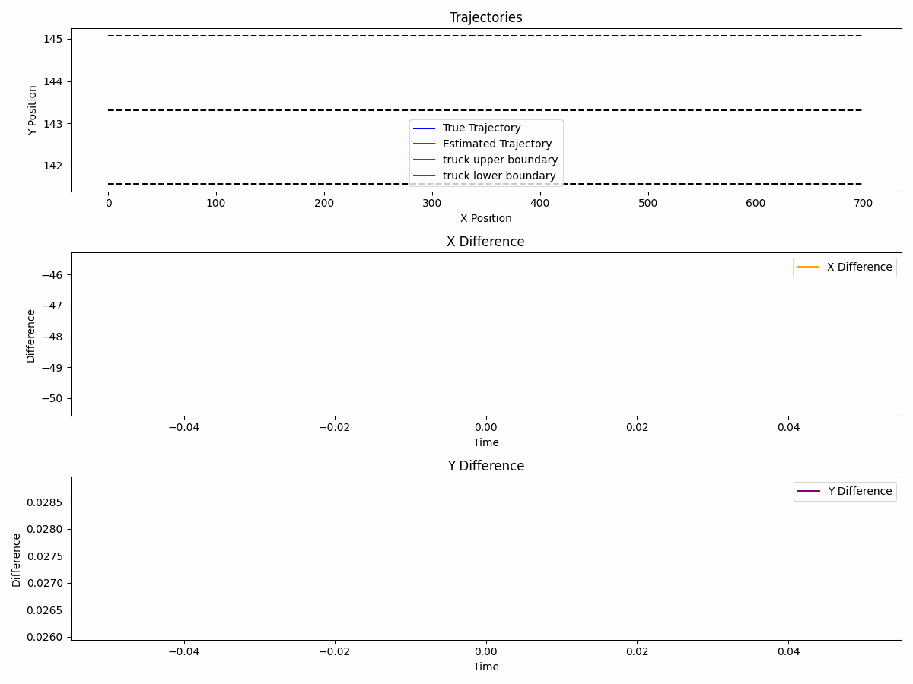
Simulation
Trailing controller

Slide 9
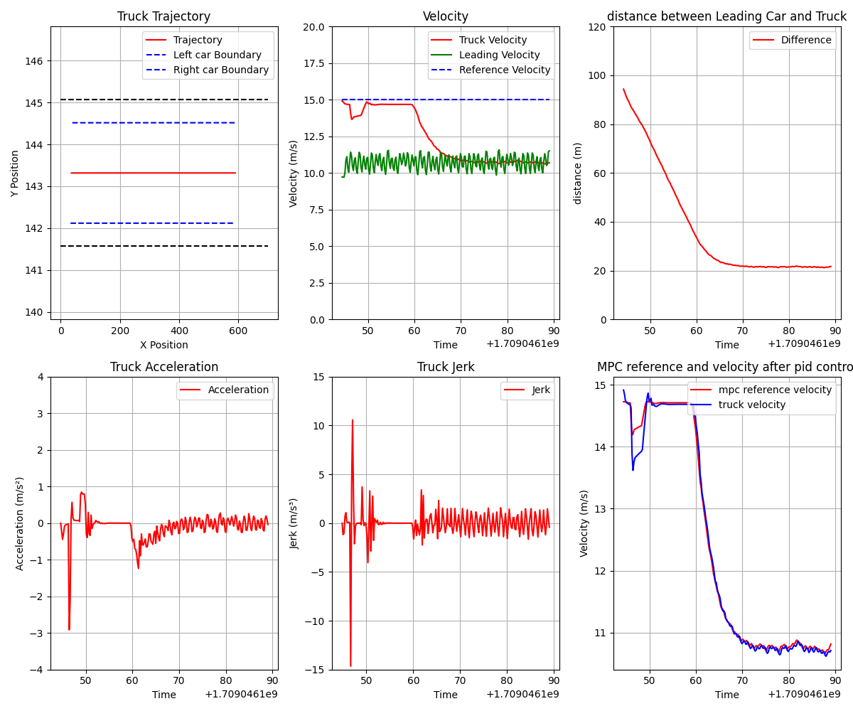
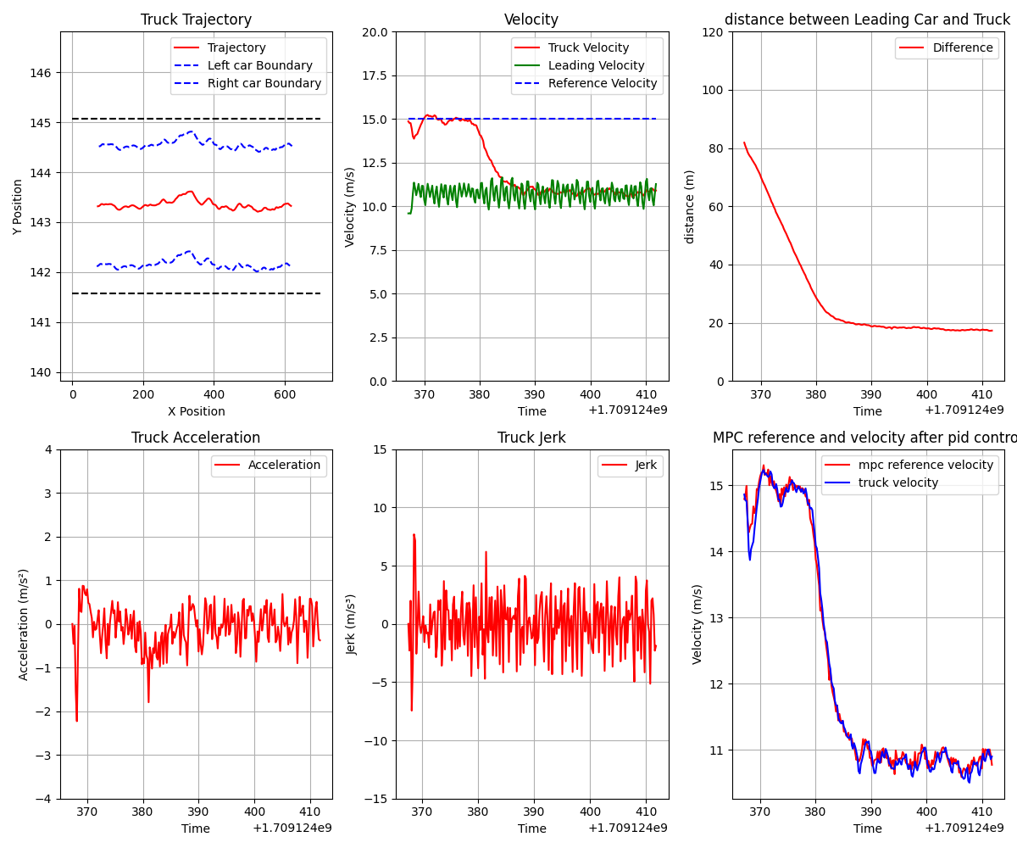
RMPC without Noise in trailing scenario
RMPC with EKF in trailing scenario

